Slide 1

New Miniature Model of Vaping

Slide 2
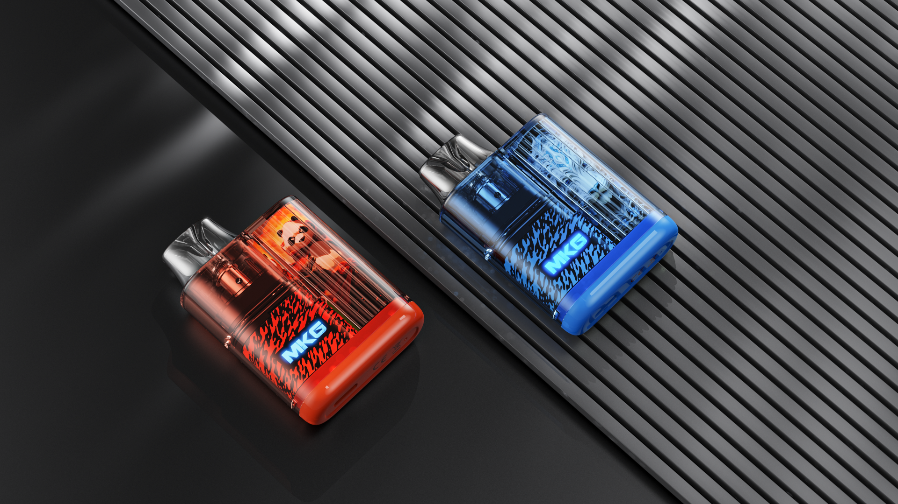
Satisfaction Up to the Last Puff

Slide 3
Colorful and Unlimited
An assortment of 4 colour options matching your every style.

Slide 4
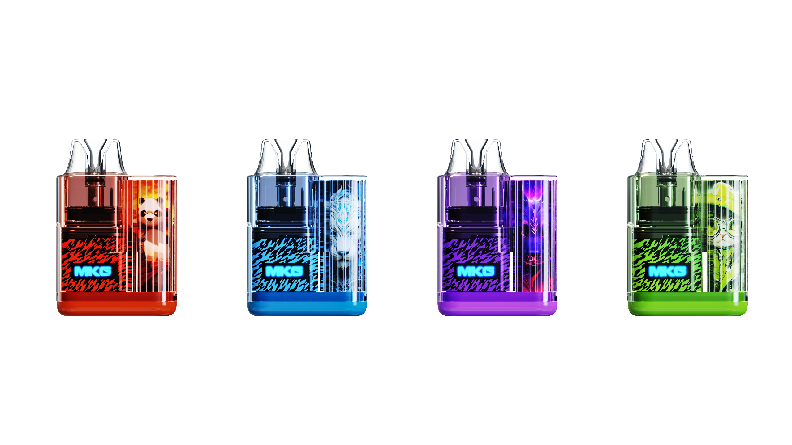
Amber
Light blue
Violet
emerald

Slide 5
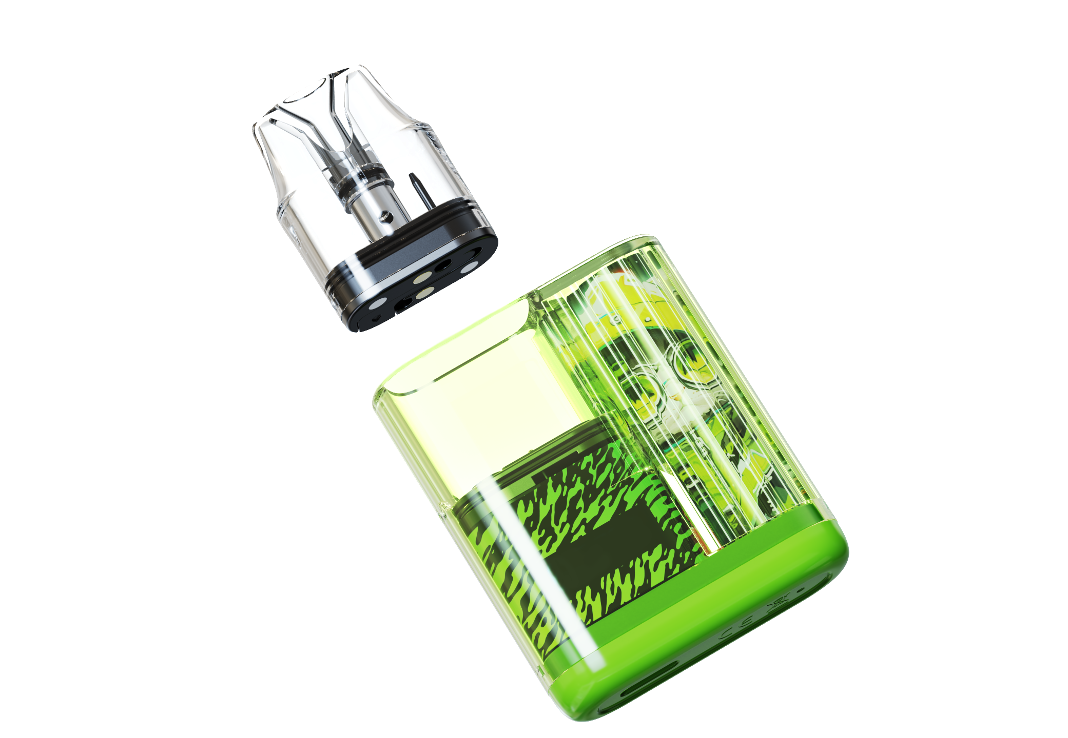
Mesh coils.
Ultimate flavor.
Long lasting life

Slide 6
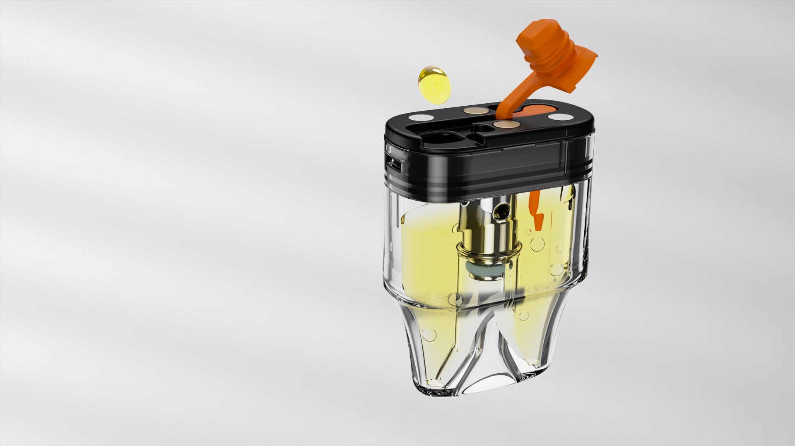
Frugal Friendly
Replaceable pod，EASY TO FILL.

Slide 7
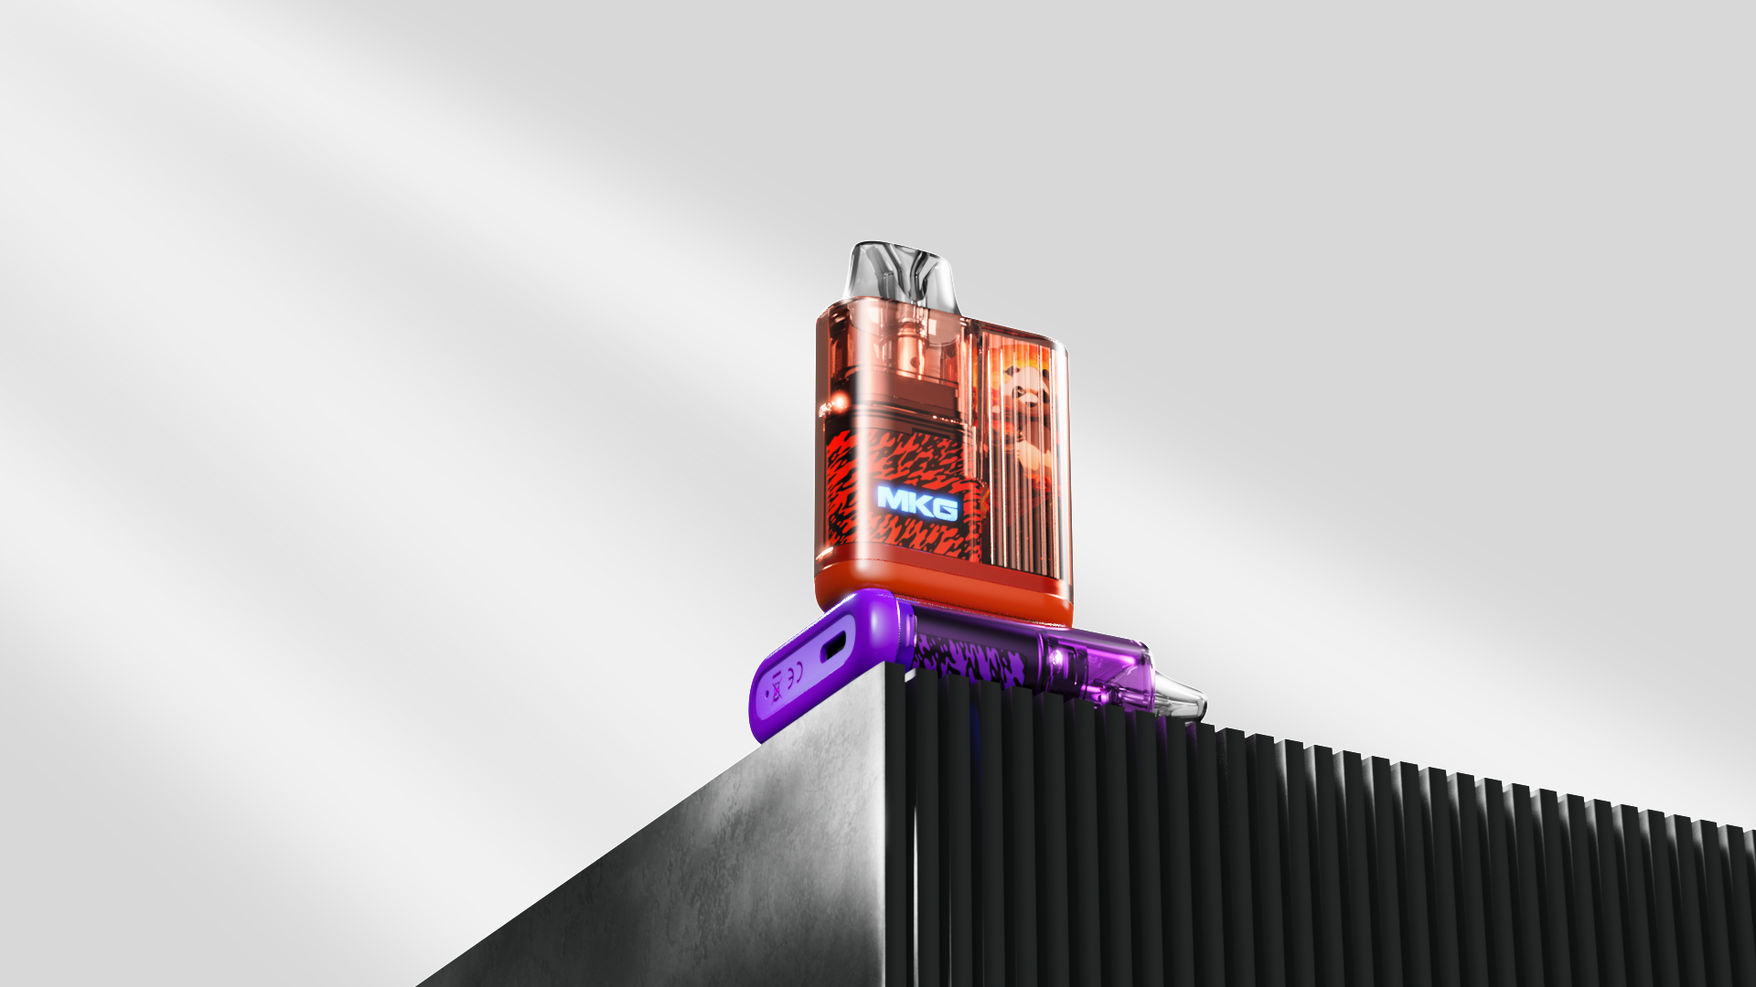
SPECIFICATIONS
Capacity : 2ml
Resistance : 1.0ΩMesh coil
Charging: Type-C
Battery capacity : 420mAh
Activation Mode: Auto-draw
Dimensions: 44.4mmx17.0mmx65.2mm

